Slide 1
TIME MAPPING

Slide 2
INTRODUCTION
Maps in general is graphical representation of features on flat surface
Maps helps to know geospatial pattern and relationship
Analysis of change is almost impossible without considering time
So, the objective of map is fulfilled by applying temporal component

Slide 3
Why Temporal Component?
Introduced to support decision making
Provide answer to following queries:
Existence of an entity
Location in time
Duration
Temporal texture
Rate of change
Sequence of entities
Synchronization

Slide 4
Time
The indefinite continued progress of existence and events in the past, present and future regarded as a whole
Can be considered linear or cyclic
This classification is complex and unclear
Has little or no use in mapping

Slide 5
Time
Mapping the time dimension following three classification of time is widely used
World time
Database time
Display time

Slide 6
TIME MAPPING
Introduction of time dimension in Geo-spatial data
Attribute space
what?
where? when?
Location space Time space

Slide 7
TIME SERIES MAPPING
Time series mapping is a technique of depicting the changes in various things and phenomenon's over the different time spans .
In this type of mapping time is a major guiding variable that directs how the changes or alterations has taken place in the past, present and will happen in the future.

Slide 8
Mapping Change
Refers to change in feature’s existence such as appearance or disappearance
Also implies to change in geometry, in attributes or both

Slide 9
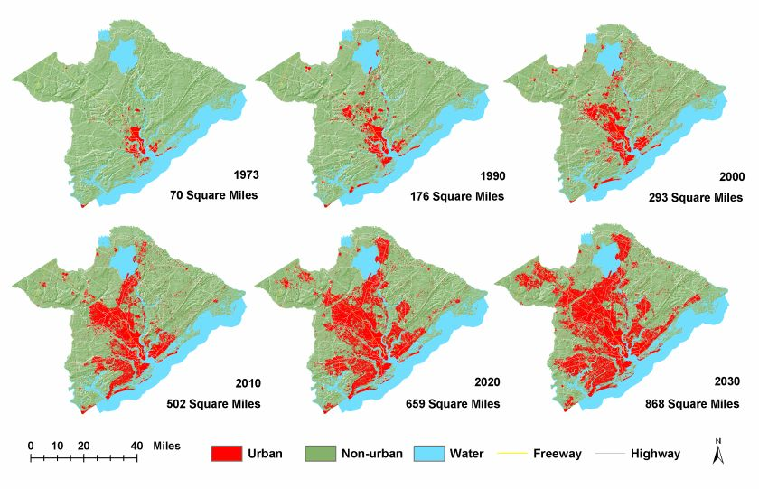
Example of change in geometry

Slide 10
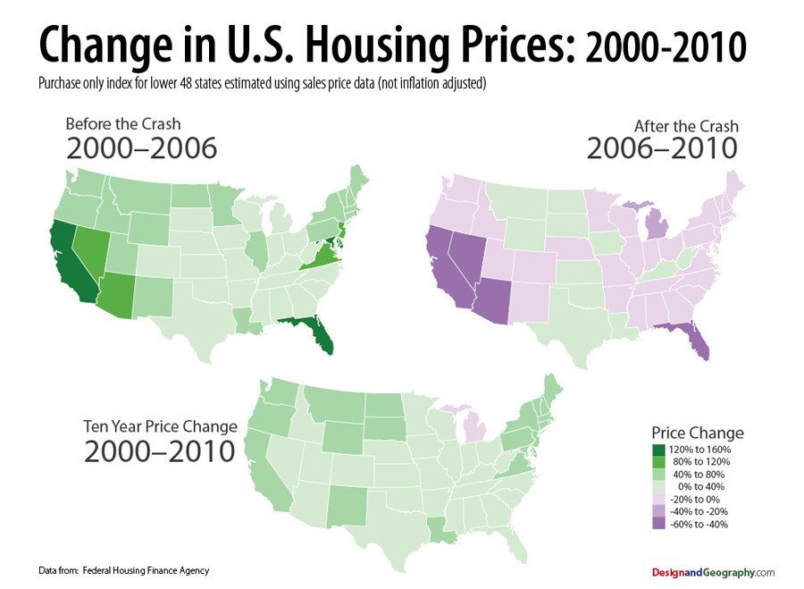
Example of change in attribute

Slide 11
Temporal Cartographic Depiction Mode
Three methods for depiction
Single Static Mode
Series Of Static Mode
Animated Map

Slide 12
Single Static Mode
A single map present
Change is shown by the use of specific graphic variables and symbols

Slide 13
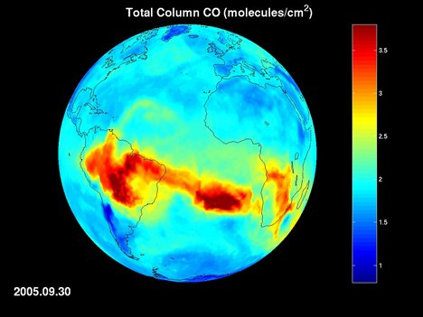

Slide 14
Series of Static Maps
Combination of maps representing snapshots at particular time
Change perceived by looking at the maps successively
The change in spatial sequence represents change in temporal sequence
Number of image must be limited

Slide 15
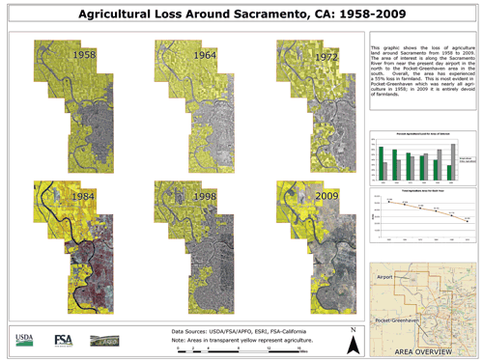
SERIES OF STATIC MAP

Slide 16
Animated Map
Can be used to generate new insights into geographic processes that had been previously unrecognized using either static maps or statistical analysis.
Allow us to represent time directly
Change is perceived to happen by displaying several snapshots in a single frame

Slide 17
Animated map
Variations introduced not from spatial sequence but from real movement of map
Classified as
Interactive animations
Non-interactive animations

Slide 18
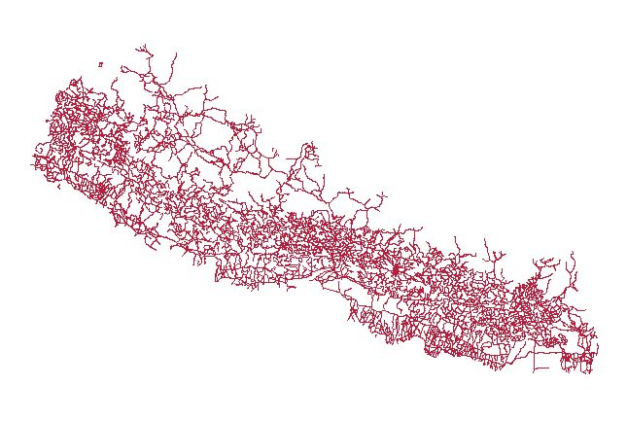

Slide 19
Animation
Animations are useful in clarifying trends and process
The development of animation took place in different phase:
First phase was manual cartoon like approach(1960’s)
Second phase developed with computer produced imagery(1980’s)
Third phase of animation is going on, created and enabled by GIS technology

Slide 20
Animation
Cartographic animations subdivided as
Temporal animations
Non temporal animations

Slide 21
Temporal Animations
Direct relation exists between display time and world time
Shows change in the locational or attribute components of spatial data
The temporal animation resolution can be seconds, years, decades,etc.
Interactive features such as play, pause, forward backwards, slow and fast must be provided .

Slide 22
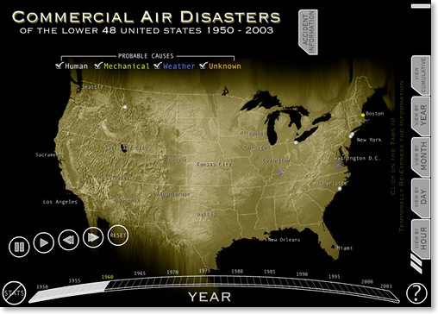
Example of Temporal animation

Slide 23
Non Temporal Animations
Animation have no direct link with the world time
But shows changes against some other variables other than time
Used to show spatial relationships or to clarify geometrical or attribute characteristics of spatial phenomena.

Slide 24
Non temporal Animation
These animations can be split into two parts
Display of build up of phenomena
Showing change in phenomena and variation brought by it.

Slide 25
Animation
Animated maps are appealing because we live in an animated world.

Slide 26
Need/Use of animations
Animated maps are an intuitive and appealing way to represent geographic processes because they allow us to represent time directly.
Animated maps aren't just about showing change over time, and non-temporal animated maps are interesting alternatives to more traditional static maps.
Map animation can be used to generate new insights into geographic processes that had been previously unrecognized.
Animations can also be very useful for explaining or providing insights into spatial relationships.

Slide 27
Dynamic Variable
For translation of spatial data into maps and ease in perceiving data we need visual variables
In animated maps along with the display movement we need graphic variables too
Along with these we need the Dynamic Variables to reinforce the traditional graphic varibles

Slide 28
Dynamic variable
Introduced by DiBaiase and MacEacheren
The most important of the dynamic variable are
Display time:
This is the time at which some display is initiated .
Duration:
The length of time nothing changes in the display. A direct link between each frame and world time exists.

Slide 29
Dynamic variable
Order:
This refers to the sequence of frames or scenes. Time is inherently ordered
Frequency:
Frequency is linked with duration, either can be defined in terms of other.
Out of these duration and order are the most important as they can describe the narrative character of animation.

Slide 30
THANK YOU

